Slide 1
Retail Orders Data Analysis: Sales Performance & Growth
Presented by
Tenali Amulya.

Slide 2
Project Objectives & Methodology
Objective : Analyze retail order data (2022-2023) to understand sales drivers, measure growth, and identify top-performing areas.
Data :orders.csv data
Methodology : 1. Data Cleaning & Transformation: Handled nulls, standardized columns, derived discount, sale price, and profit.
2. Database Integration: Used SQLAlchemy to load cleaned data into MySQL
3. Analytical Querying: Executed complex SQL queries (using CTEs, Window Functions) to answer business questions. 4. Visualization: Generated insights using Pandas and Matplotlib.
Tools Used : Python, Pandas, Matplotlib, SQLAlchemy, MySQL.

Slide 3
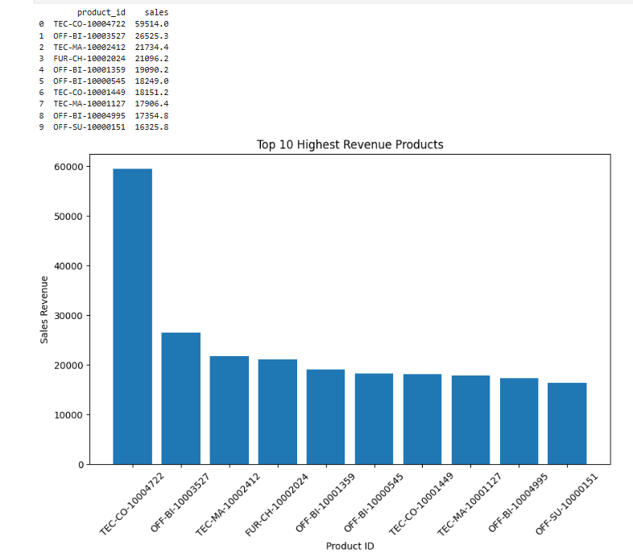
Insight 1: Top 10 Revenue Products
Identify the top 10 products contributing the highest total sales revenue.
The top-selling product is TEC-CO-10004722, generating over 60,000 in sales (approx. 60K).
Actionable Takeaway: Prioritize marketing and stock levels for TEC-CO-10004722 and other top-tier SKUs to maximize profit capture.

Slide 4
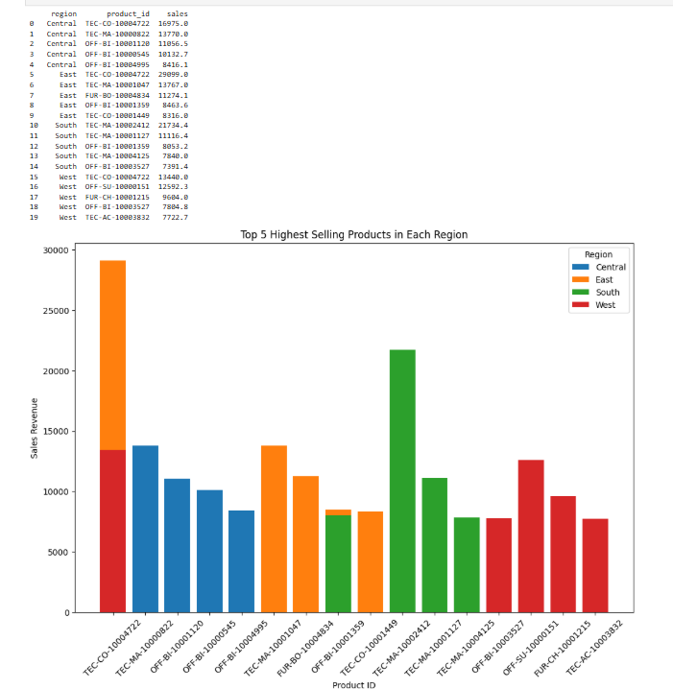
Insight 2 :Top 5 Selling Products per Region
Central region's top product (TEC-CO-10004722) has sales of 17K, while the West region's top product (TEC-CO-10004722) has sales of 30K.
Observation: TEC-CO-10004722 appears as a top seller in multiple regions, indicating universal high demand.
Actionable Takeaway : Implement region-specific promotions, ensuring the top 5 products for each region are always in stock locally.

Slide 5
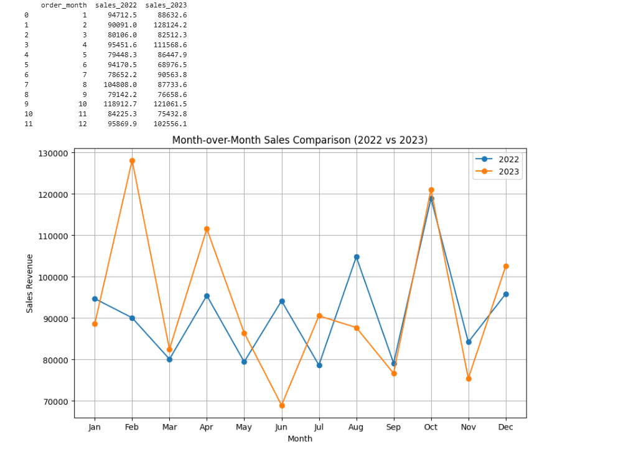
Insight 3: Month-over-Month (MoM) Sales Growth (2022 vs 2023)
Peak Sales : 2023 hit its peak in February (128K) and October (121K). 2022 peaked in October (105K).
Growth Period : February 2023 showed exceptional performance, far exceeding February 2022.
Actionable Takeaway :Investigate the cause of the November 2023 drop and plan strategic campaigns to stabilize year-end performance

Slide 6
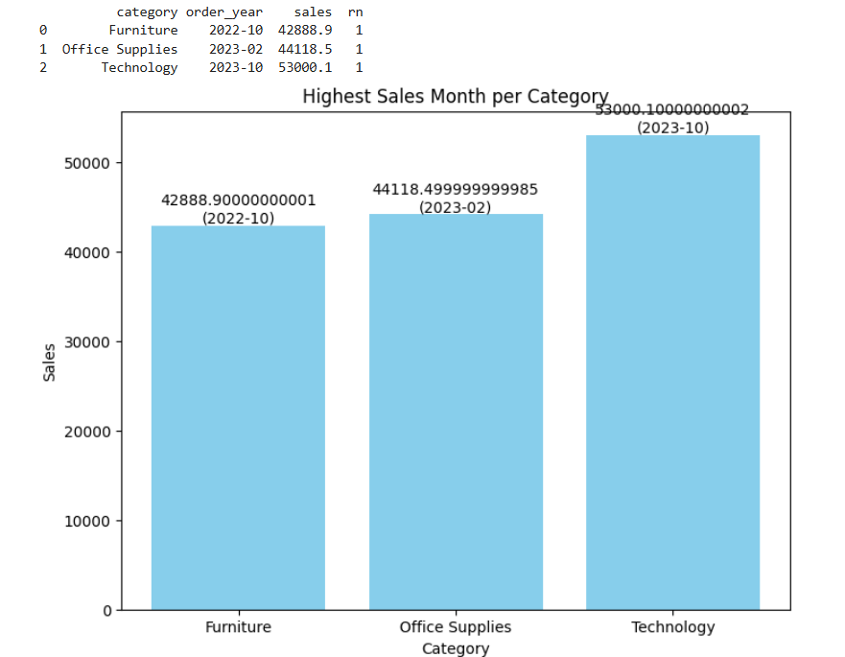
Insight 4: Category Peak Sales Month
Key Findings: Technology: Peak in Oct-2023 (53K). Office Supplies: Peak in Feb-2023 (44.1K). Furniture: Peak in Oct-2022 (42.9K).
Observation : Peak sales events are distributed across the year, suggesting distinct seasonal drivers for different categories.
Actionable Takeaway: Schedule major marketing budgets and inventory boosts based on these historical peak months for each category.

Slide 7
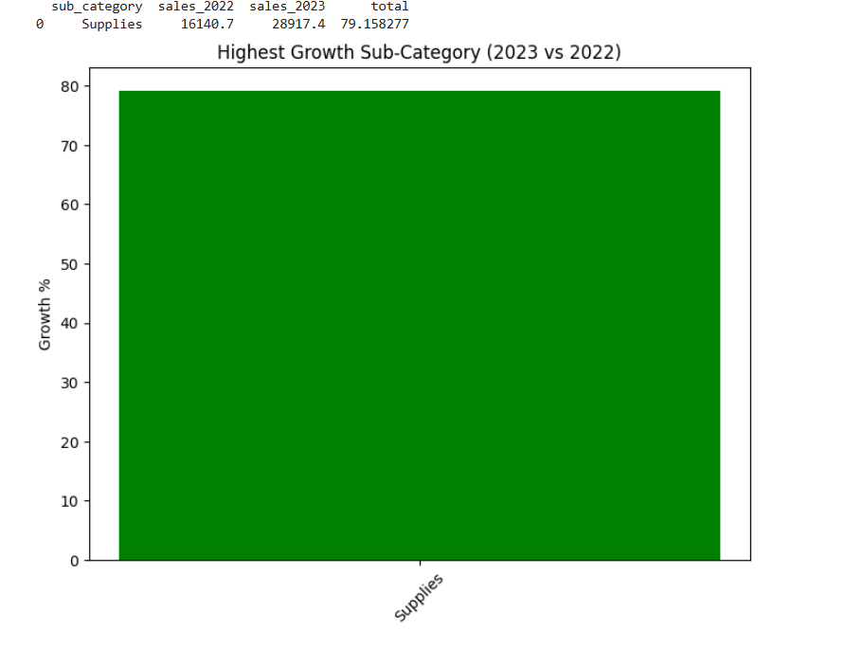
Insight 5: Highest Sales Growth Sub-Category (2023 vs 2022)
Key Finding : The Supplies sub-category showed the highest growth rate: 79.16%.
Sales Change : Supplies grew from $16,140.7 in 2022 to $28,917.4 in 2023.
Actionable Takeaway : Analyze the Supplies category to understand the factors driving this exceptional growth (e.g., new products, pricing, or marketing effectiveness) and apply those lessons elsewhere.

Slide 8
Project Summary
Successfully executed an end-to-end data analysis pipeline spanning ETL (Pandas), Database integration (SQLAlchemy/MySQL), and Business Intelligence reporting (Matplotlib).

